Slide 1
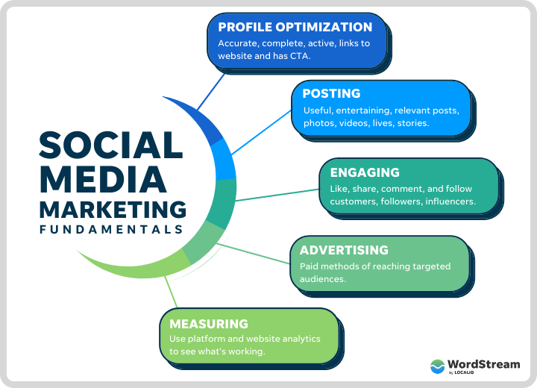
Social Media Marketing

Slide 2
Agenda
Introduction to Digital Marketing
Online Marketing Overview
Email Marketing Strategy
Social Media Marketing Essentials
Tools & Best Practices
Case Studies / Examples
Conclusion & Q&A

Slide 3
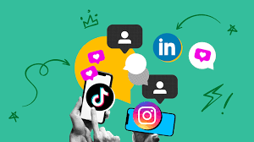
Content

Slide 4
What is Digital Marketing?
Use of digital channels to promote products/services
Key Channels: Websites, Email, Social Media, SEO, PPC
Data-driven and measurable

Slide 5
Online Marketing Overview
Encompasses all web-based marketing strategies
Includes SEO, Content Marketing, PPC, and Website Optimization
Social media marketing (SMM) involves using social media platforms to connect with an audience, build a brand, increase sales, and drive website traffic.
It's a form of internet marketing that utilizes social media apps to achieve these goals, including publishing engaging content, interacting with followers, analyzing results, and potentially running advertisements.

Slide 6
Key Components of Social Media Marketing:
Platform Selection:
Identifying the most relevant social media platforms for your target audience (e.g., Instagram, Facebook, X, LinkedIn, TikTok).
Content Creation and Publishing:
Developing and sharing high-quality, engaging content (text, images, videos, etc.) that aligns with your brand and resonates with your audience.
Community Engagement:
Interacting with followers, responding to comments and messages, and fostering a sense of community around your brand.
Social Media Advertising:
Utilizing paid advertising options on social media platforms to reach a wider audience and drive specific actions (e.g., website clicks, conversions).
Performance Measurement and Analysis:
Tracking key metrics (e.g., engagement rates, website traffic, sales) to assess the effectiveness of your social media marketing efforts and make data-driven adjustments.

Slide 7
Benefits of Social Media Marketing:
Increased Brand Awareness:
Social media provides a powerful platform to showcase your brand and reach a large and diverse audience.
Targeted Audience Reach:
Social media algorithms allow for precise targeting, ensuring your message reaches the most relevant potential customers.
Direct Customer Engagement:
Social media facilitates direct interaction with customers, enabling you to build relationships and address their needs.
Website Traffic Generation:
Social media can be a significant source of traffic to your website, driving potential customers to learn more about your products or services.
Cost-Effective Marketing:
Compared to traditional advertising methods, social media marketing can be a more budget-friendly option, especially for small businesses.
Improved Customer Service:
Social media platforms can be used to provide timely and efficient customer support, resolving issues and answering questions.
Enhanced SEO:
Social media activity can indirectly improve your website's search engine ranking, as it signals to search engines that your brand is active and relevant, according to some SEO experts.

Slide 8
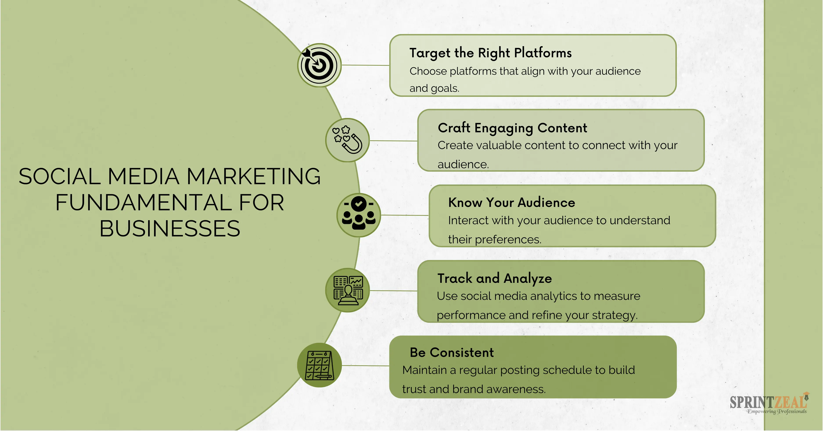
Fundamentals of Social Media Marketing& its significance

Slide 9
Fundamentals of Social Media Marketing
Social media marketing fundamentals encompass understanding your audience, defining clear objectives, selecting appropriate platforms, creating engaging content, fostering interaction, and tracking performance.
These core principles are crucial for building brand awareness, driving traffic, and achieving marketing goals.

Slide 10
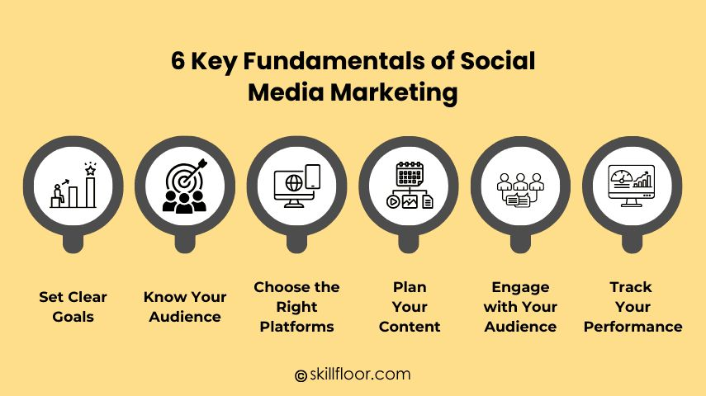
Fundamentals of Social Media Marketing

Slide 11
Fundamentals of Social Media Marketing:
Define Objectives:
Start by clearly outlining what you want to achieve with your social media efforts. Are you aiming to increase brand awareness, drive website traffic, generate leads, or boost sales?
Know Your Audience:
Understanding your target audience's demographics, interests, and online behavior is essential for creating relevant and engaging content.
Choose the Right Platforms:
Different social media platforms cater to different audiences and content formats. Select the platforms where your target audience is most active.
Content is King:
Create high-quality, valuable, and engaging content that resonates with your audience. This could include text, images, videos, or a combination of formats.
Engage with Your Audience:
Social media is a two-way communication channel. Respond to comments, messages, and participate in relevant conversations to build relationships and foster a sense of community.
Track Performance:
Use social media analytics to monitor your progress, identify what's working, and optimize your strategy accordingly. Track metrics like engagement, reach, and website traffic.
Be Authentic:
Authenticity is key to building trust and credibility. Be genuine in your interactions and let your brand's personality shine through.

Slide 12
Significance of Social Media Marketing
Broad Reach:
Social media platforms allow you to reach a vast and diverse audience, including potential customers who may not be easily accessible through traditional marketing methods.
Targeted Advertising:
Social media platforms offer sophisticated targeting options, allowing you to reach specific demographics, interests, and behaviors, maximizing the effectiveness of your advertising campaigns.
Cost-Effective:
Compared to traditional advertising, social media marketing can be a cost-effective way to reach your target audience, especially for small businesses.
Enhanced Brand Awareness:
Social media is a powerful tool for building brand awareness and recognition, as it allows you to showcase your brand's personality, values, and offerings.
Improved Customer Engagement:
Social media provides a platform for direct interaction with customers, allowing you to build relationships, address concerns, and foster a sense of community.

Slide 13
Continue
Website Traffic and SEO:
Social media activity can drive traffic to your website, and social signals can positively impact your search engine optimization (SEO) efforts.
Data and Insights:
Social media analytics provide valuable data and insights into your audience's behavior, preferences, and engagement patterns, allowing you to refine your marketing strategies.
Customer Feedback:
Social media provides a direct channel for gathering customer feedback, allowing you to identify areas for improvement and enhance your products or services.
Building a Community:
Social media allows you to build a loyal community around your brand, fostering a sense of belonging and encouraging customer advocacy.
Adaptability:
Social media is constantly evolving, with new platforms and trends emerging. This means social media marketers need to be adaptable and willing to learn new strategies and techniques.
By understanding and implementing these fundamentals, businesses can leverage the power of social media to achieve their marketing goals and build a strong online presence.

Slide 14
Necessity of Social Media Marketing,
1. Enhanced Brand Awareness and Visibility:
Social media platforms offer unparalleled reach, connecting businesses with a vast and diverse audience.
By actively engaging on social media, businesses can increase their visibility and build brand recognition, making it easier for potential customers to discover and learn about their products or services.
Increased visibility leads to more opportunities for customer engagement and potential sales.
2. Targeted Advertising and Audience Engagement:
Social media platforms allow for precise targeting, enabling businesses to reach specific demographics, interests, and behaviors.
This level of targeting ensures that marketing messages are delivered to the most relevant audience, maximizing the effectiveness of advertising campaigns.
Social media also facilitates direct engagement with customers, allowing businesses to respond to questions, comments, and feedback in real-time, fostering stronger relationships and building customer loyalty.
3. Cost-Effective Marketing Solutions:
Compared to traditional marketing methods, social media marketing offers a more cost-effective approach, especially for small businesses with limited budgets.
Businesses can reach a large audience with minimal investment, making it an accessible and efficient way to promote their products and services.

Slide 15
continue
4. Driving Website Traffic and Conversions:
Social media posts with links to a business's website can drive traffic directly to the site, increasing the potential for leads and sales.
By strategically sharing content and engaging with users, businesses can guide them through the sales funnel and encourage conversions.
5. Competitive Advantage:
In today's competitive landscape, having a strong social media presence is crucial for staying ahead of the competition.
By actively participating in social media conversations and monitoring competitor activity, businesses can adapt their strategies and maintain a competitive edge.
6. Improved Customer Service and Relationships:
Social media provides a platform for direct communication with customers, allowing businesses to address their concerns and provide prompt support.
Responding to customer feedback and inquiries quickly and effectively can improve customer satisfaction and loyalty.
7. Data-Driven Insights:
Social media platforms provide valuable data analytics and insights into audience behavior and engagement.
Businesses can use this data to understand what content resonates with their audience, refine their strategies, and optimize their marketing efforts for better results.

Slide 16
Building a Successful strategy: Goal Setting, Implementation.
Create marketing goals. ...
Learn about your audience. ...
Choose the right platform. ...
Create content for social media. ...
Check your competition. ...
Create a content calendar. ...
Engage with your audience. ...
Track social media metrics.

Slide 17
Key Components of Online Marketing
Search Engine Optimization (SEO)
Pay-Per-Click (PPC) Advertising
Content Marketing (blogs, videos, eBooks)
Affiliate & Influencer Marketing

Slide 18
What is Email Marketing?
Direct communication via email to promote offerings
High ROI: ~$42 for every $1 spent (DMA)

Slide 19
Types of Email Campaigns
Newsletters
Promotional Emails
Drip Campaigns
Transactional Emails
Re-engagement Campaigns

Slide 20
Best Practices in Email Marketing
Segment your audience
Personalize subject lines and content
Optimize for mobile
A/B testing
Clear CTA (Call-To-Action)

Slide 21
Introduction to Social Media Marketing
Use of platforms to connect with audience, build brand, drive traffic & sales
Major platforms: Facebook, Instagram, LinkedIn, Twitter/X, TikTok, YouTube

Slide 22
Platform-Specific Strategies
Facebook & Instagram: Visual storytelling, ads, stories
LinkedIn: B2B networking, thought leadership
Twitter/X: Real-time updates, trends
TikTok & YouTube: Short/long-form video marketing

Slide 23
Social Media Metrics
Engagement Rate
Reach & Impressions
Click-Through Rate (CTR)
Follower Growth
Conversions

Slide 24
Tools & Platforms
Online Marketing: Google Ads, SEMrush, Ahrefs
Email Marketing: Mailchimp, HubSpot, ConvertKit
Social Media: Hootsuite, Buffer, Canva, Meta Business Suite

Slide 25
Case Study Example
Brand: Nike
Channel: Social Media Campaign
Outcome: X% increase in engagement, Y% increase in sales

Slide 26
Summary
Combine online, email, and social media for integrated marketing
Use analytics to refine strategies
Focus on personalization and engagement

Slide 27
Q&A
Thank you!
Questions?

